Slide 1

Faculty of English
English 3

Slide 2
LECTURE 6
Teachers
Speaking: Question 3
Describe a picture

Slide 3
Marking Criteria
01
Pronunciation, Intonation, Stress
03
Vocabulary
02
04
Grammar
Cohesion

Slide 4
How to describe?
Use adjectives, adverbs, prepositions, quantifiers... to add details.
Identify:
People, things, location, actions
Make guesses if you’re not sure

Slide 5
SPEAKING TIPS
TIP 1
TIP 2
Be sure to use the correct noun or pronoun and the correct verb form
Use specific verb tenses and structures for basic descriptions.

Slide 6
SPEAKING TIPS
TIP 3
TIP 4
TIP 5
Use prepositions and adverbs to talk about location and how things move.
Use adverbs to give more information about verbs.
Use adjectives to give more information about people and objects

Slide 7
Location (Prepositions) | Direction (Adverbs)
- at the front; in the back - in front of; behind - on the left / right; in the center (middle) - below; above; at the top /bottom; underneath - next to; in the corner; at the corner; on the side | - forward; backward; toward; away from - ahead; behind; toward the front /back - to the left / right; toward the center - from above /below; under; over - next to; toward the corner; to the side

Slide 8
SPEAKING TIPS
TIP 4
TIP 5
Use adverbs to give more information about verbs.
Use adjectives to give more information about people and objects

Slide 9
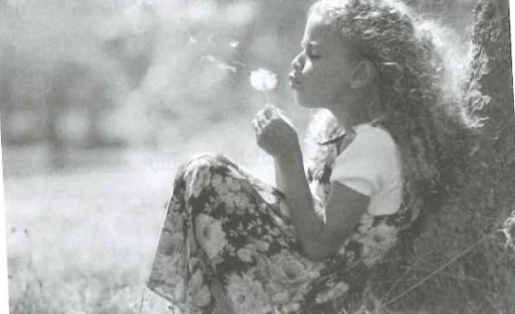
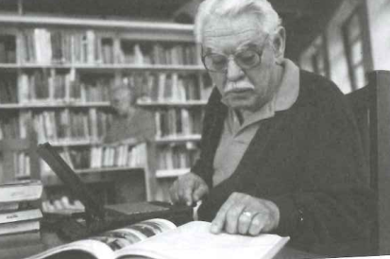
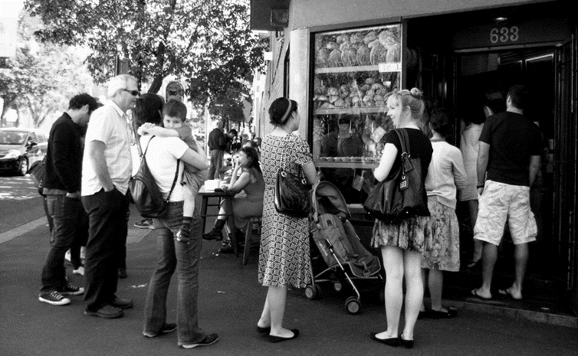
Examples
Adj + N
This is a picture of a girl. She has blonde wavy hair. She is wearing a flowered dress.
Adj + N and adj +N
The man has a mustache and white hair and he is wearing a red cadigan.
V + adv
(probably/possibly/sometimes ...+V)
The customers are waiting patiently to buy some fresh bread.

Slide 10
4.
Cohesion and structuring a response

Slide 11
How to structure your response?
TIP 1 Organize your response in a clear way
TIPS
TIP 3 If you are not sure, make guesses.
TIP 2 Keep your responses coherent and easy to understand.
Use transitions and conjunctions like However, Apparently, and, but, although, and because, and use phrases like It seems to me that, It seems like, and It appears that.
- Refer to the photo.
- Say who is in the photo.
- Say where the person or people are.
- Say what the person or people are doing.
Probably, possibly, maybe, perhaps, it’s likely that, it seems that…..

Slide 12
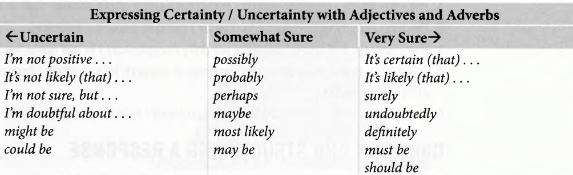
Tip 3: make guesses

Slide 13

HOMEWORK
- Do Progressive Practice (P.24-25)
- Pre-read: Writing Question 6-7 (P.111-P.115)

Slide 14


